Slide 1
DOM.
Document Object Model & Manipulation

Slide 2
Objectives
Explain the DOM
Practice manipulating elements
Familiarize yourself with the JavaScript methods and properties that relate to the DOM

Slide 3
DOM
Document Object Model
Way the browser let developers manipulate web pages with JavaScript.

Slide 4
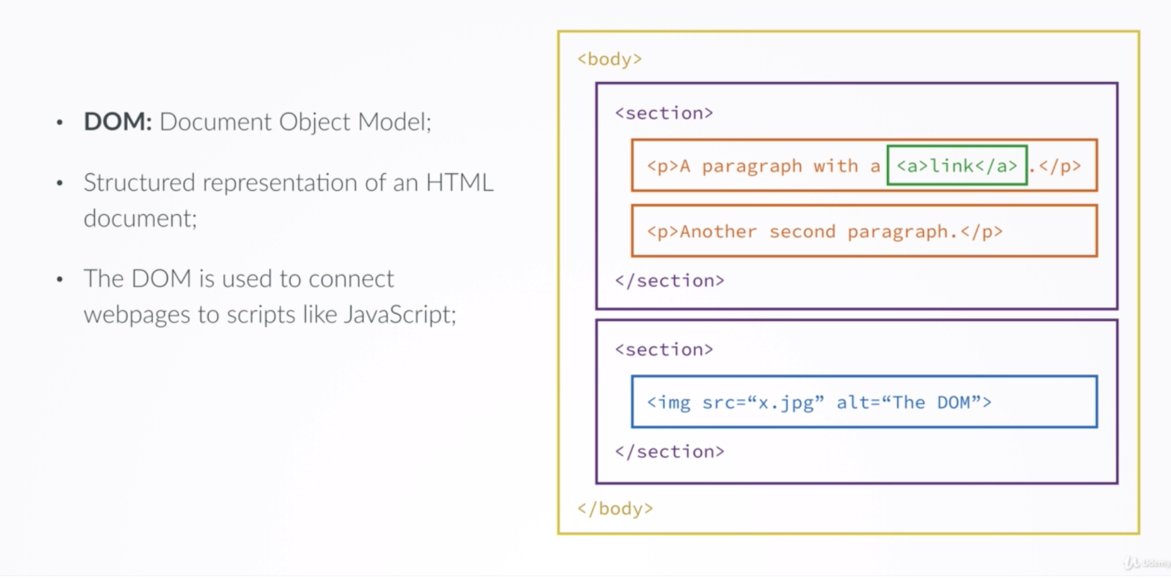
DOM

Slide 5

JS + DOM

Slide 6
Review: What are methods?

Slide 7
Review: What are methods?
Methods are functions attached to objects
Hold on to that thought!
Methods

Slide 8
When a browser loads a webpage:
Parses HTML & CSS
Converts the document
into a DOM
(A big JavaScript Object)

Slide 9
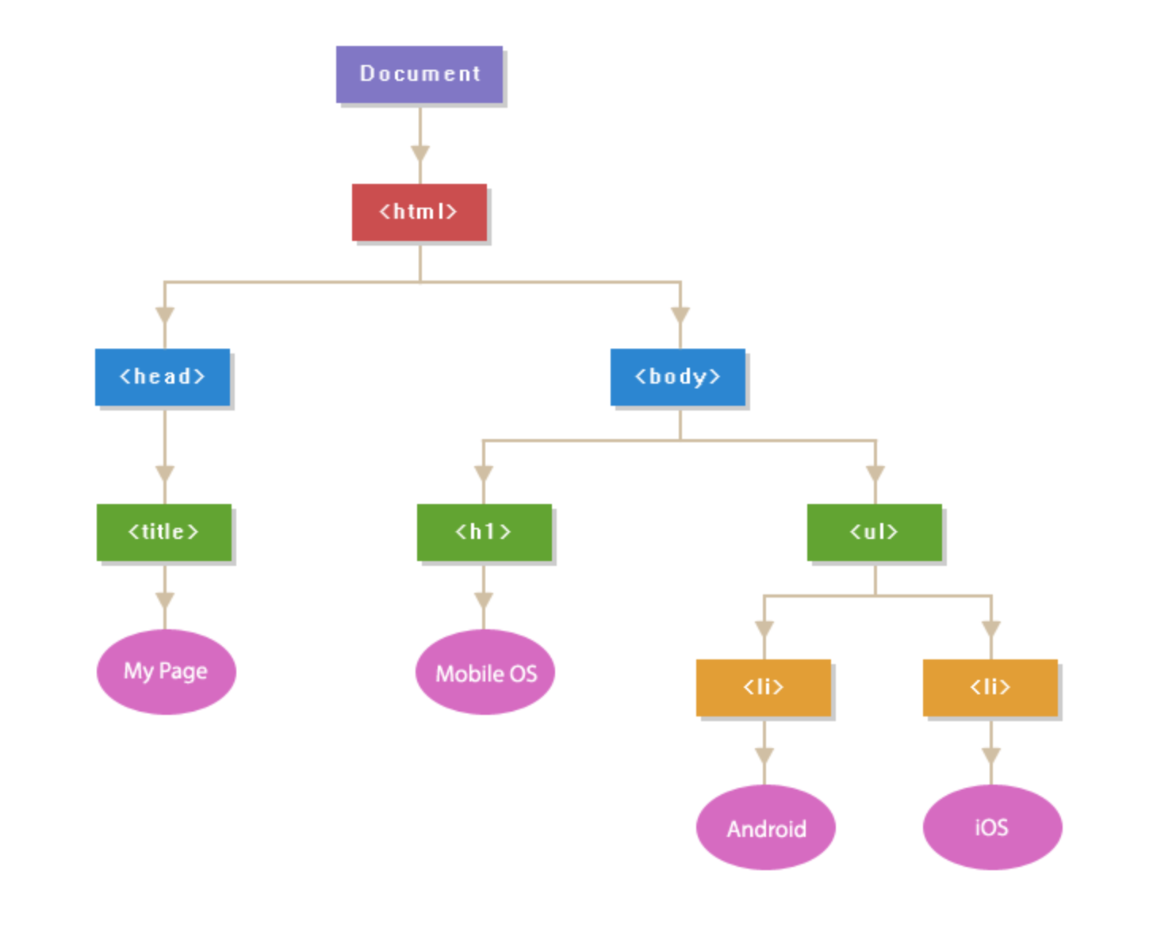
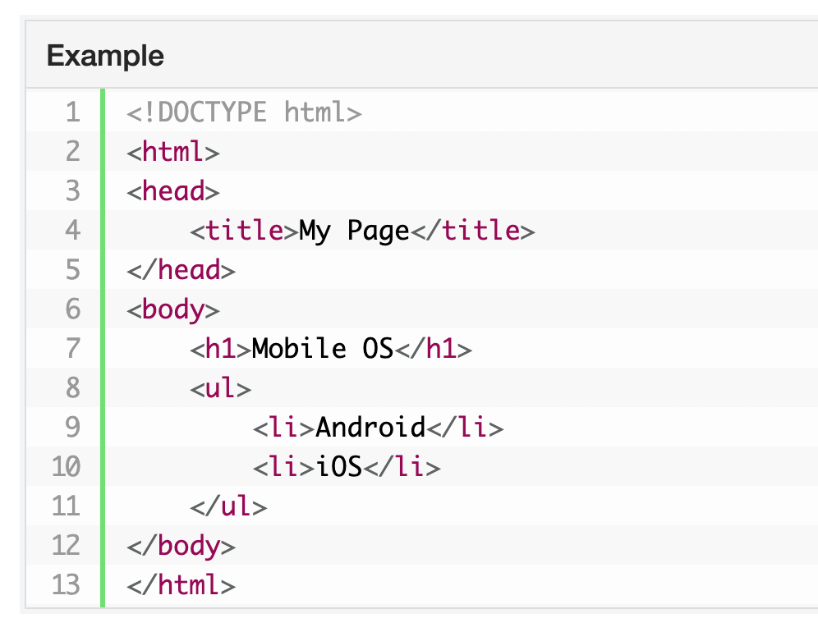
The DOM Tree

Slide 10
document
A global variable that it used to get access to the DOM
The document object contains methods and call functions

Slide 11
Challenge Set Up
In VS Code…
Create an index.html file with a HTML skeleton
Create a script.js file
Link the script.js in the script tag located in the index.html

Slide 12
Challenge #1 Use JavaScript
Access: Find the DOM node using an access method
document.body
2. Modify: Manipulate the DOM node
by adding a sentence
document.body.innerHTML = “This is sus”
NOTE: You can change attributes, styles, inner HTML, or append new nodes.

Slide 13

Why did this work???

Slide 14

Why did this work?
The browser is watching for changes in the document object
As soon as it detects a change it reflects it back

Slide 15
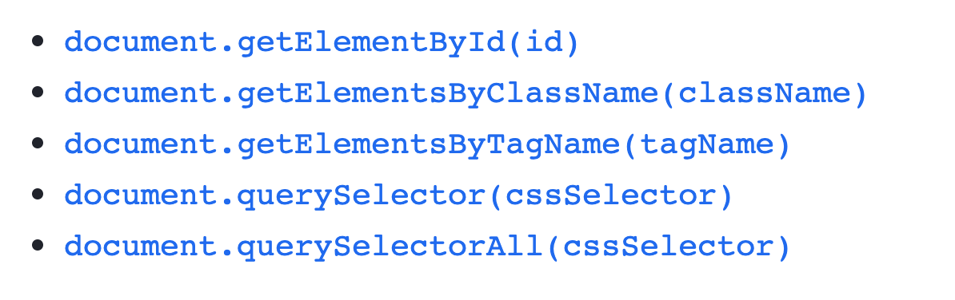
What methods can we use?

Slide 16
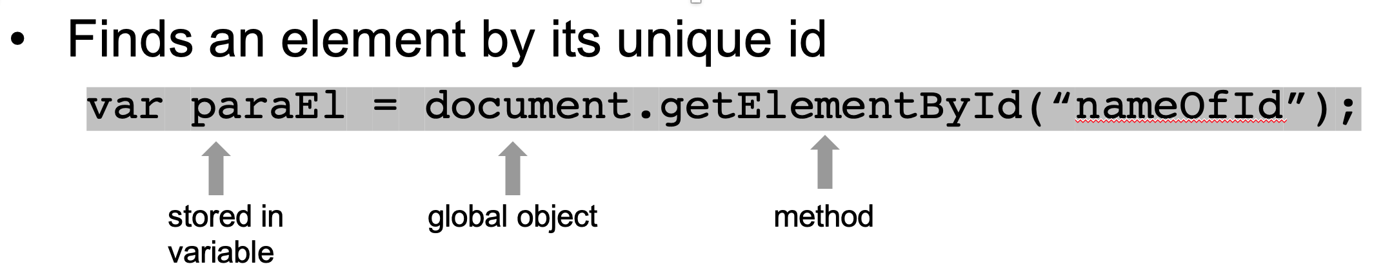
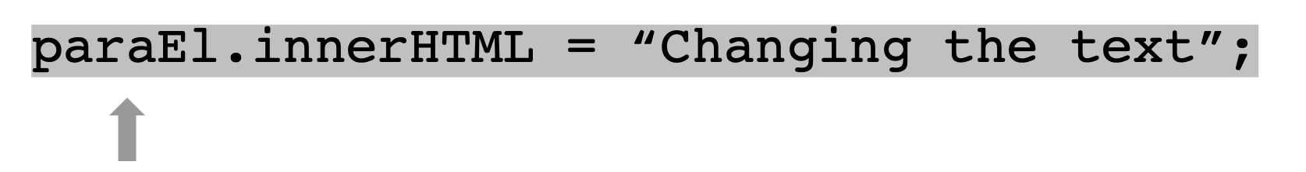
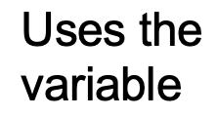
getElementById

Slide 17
Challenge #2
Add the following elements to your HTML file:
<h1 id=“heading”>My initial heading </h1>
<h2> Another paragraph element</h2>
<p> Simple paragraph element</p>
Save the h1 element to a variable named headingEl using its id
Modify the headingEl so the browser displays:
We Got This!
If you have time, change another elements or test out another method.

Slide 18
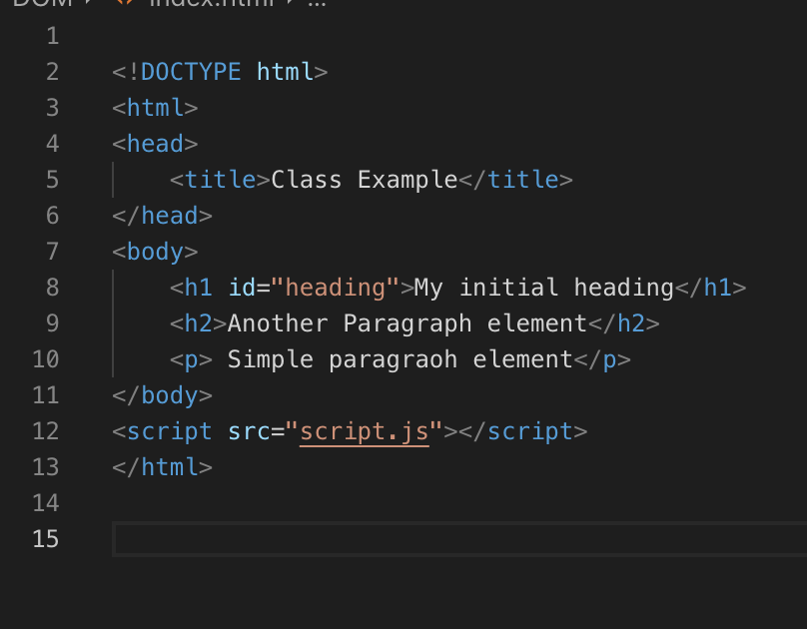
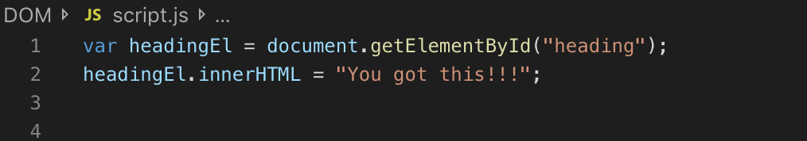
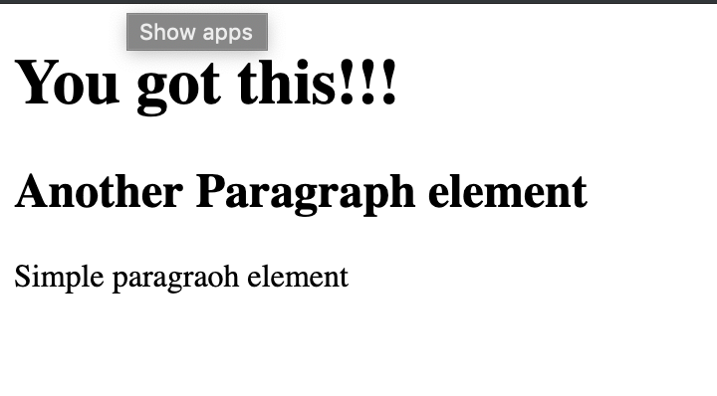
Challenge #2 Answer

Slide 19

Killing it!

Slide 20
Resources
https://developer.mozilla.org/en-US/docs/Web/API/Document_Object_Model
https://www.w3schools.com/js/js_htmldom.asp
https://www.youtube.com/watch?v=hM9h1wN4rfU

